Slide 1
Analysis on Car Sales
Prepared By : Saurabh Javir
Guide By : Vishal Sir

Slide 2
Content :
Introduction
Key Column Include
Key findings
Data description
Summary of the Dataset
Data Transformation
Key Insights
Conclusion
Recommendations

Slide 3
Introduction :-
The dataset consists of 188,675 rows and 16 columns, capturing various details about vehicles.
Key columns include:
year: The sale year of the vehicle in that there are two years of data from 2014 to 2015.
make and model: The brand and model ( fusion , range ,ghost) of the vehicle.
trim and body: Additional vehicle details like trim (version or special varient ) (LX,SE)and body style (e.g., sedan, suv).
transmission: Type of transmission (e.g., automatic , manul ).
This dataset analyze trends in vehicle sales, body type and other attributes and across different locations

Slide 4
key findings:-
Vehicle Age: The dataset covers vehicles from a wide range of sale years, indicating a mix of new and older vehicles.
Popular Makes and Models: Certain vehicle makes are ford and model is Fusion and body type is sedan is are more common in the dataset, which can suggest trends in popularity or market demand. Avg price of the popular makes and model are 13600
Geographical Distribution: The state column in dataset allowing for analysis of regional trends in vehicle sales . In that top most state are fl,cal,pe has top most sale are sales by the the hertz corporation , body type sedan , model is altima and maker is also same that is Ford
Transmission Type :
- There is variation in the type of transmission (e.g., automatic or manual), which can provide insights into consumer preferences in that most of the buyer buy the tansmission type automatic.
manual- 3519
automatic-163092

Slide 5
Data description:-
year (year of the vehicle sale)
make (vehicle manufacturer)
model (vehicle model)
trim (specific version of the vehicle)
body (type of vehicle body, e.g., SUV, sedan)
transmission (automatic/manual transmission)
Summary of the dataset:-
Number of rows: 188,675
Number of columns: 16
Date range: From January 1, 2014, to July 14, 2015

Slide 6
Data transformation :-
The saledate column transform that data into month column and year column because in the dataset there already one column year that mean in which year car is build that data is not mean for us that’s why transform saledate into month and year column
in the year column there are so many data in that data some value are nan that’s why when we converting that datatype into int its give error :-
IntCastingNaNError: Cannot convert non-finite values (NA or inf) to integer
to solve this first we need to fill that nan value with fillna zero(0)

Slide 7
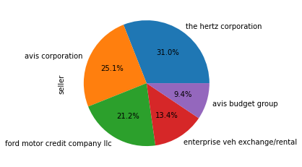
Key insights :
We analyse :
1)Top most seller are and its Top most make(brand) and which type of body type sale most
From the below table we analyse that the top seller sale the chevorlet brand (make) and the body type is sedan
Seller | make | Body type
The hertz corporation | Chevorlet | sedan
Avis corporation | Chevorlet | sedan
Ford motor credit company llc | Ford | suv
Enterprise veh exchane/rentel | Chevorlet | sedan
avis budget group | Ford | sedan

Slide 8
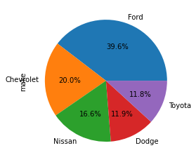
2) Top most make and its body type and model most sale and it’s transmission is automatic and its count
In the below table we see the top most maker sale body type sedan from different makes(brand)
Sr.no | Make | Body type | Body Count | Model | Model count | Transmission
1 | Ford | sedan | 13013 | fusion | 6291 | automatic
2 | Chevrolet | sedan | 10639 | cruze | 4075 | automatic
3 | Nissan | sedan | 9553 | altima | 6074 | automatic
4 | Dodge | sedan | 4808 | Grand-caravan | 3771 | automatic
5 | Toyota | sedan | 7527 | carmry | 4171 | automatic

Slide 9
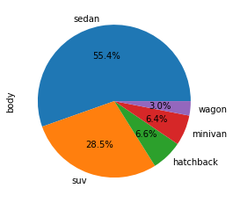
3) Top most body type sale and which company make that body type and its rating grater than avrage ratings
and its count to check which is best out of these
Body type | Maker | Count of body
sedan | Ford | 10816
suv | Ford | 11314
hatchback | Ford | 2417
minivan | dodge | 2077
wagon | kia | 1398

Slide 10
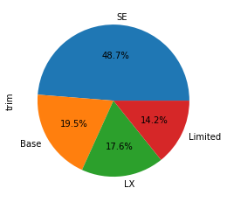
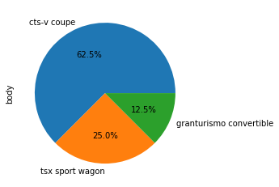
4) Top most trim sale and which make are make that most and rating grater than avrage rating
trim | make | count
SE | Ford | 13094
Base | Lexus | 2204
LX | Kia | 5457
Limited | Ford | 2959
5) Rarer body type sale and its make(brand) and its ratings
Body type | maker | Rating(condition)
Ctd-v coupe | Cadillac | 12.8
Tsx sport wagon | Acura | 45.5
Granturismo convertible | maserati | 49.0

Slide 11
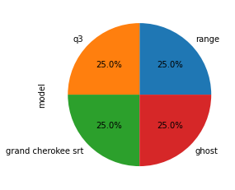
6)Rarer model sale and its make (brand) and its condition
model | make | condition
q3 | Audi | 5.0
range | Land rover | 43.0
ghost | RollsRoyce | 42.0
grand cherokee srt | jeep | 47.0

Slide 12
7) Which rare color car sale most that are use in exterior
Interior_color | make | model | Body type
lime | Ford | mustang | coupe
pink | chevrolet | spark | hatchback
8) Which rare color car sale most that are use in interior and its make
Exterior_color | make | model | Body type
yellow | chevrolet | spark | hatchback
orange | BMW | X6,X5,X1 | suv
orange | Nissan | Versa note,juke | hatchback

Slide 13
Year wise analysis on the basis of month, seller, maker,body type, model and its avg ratings
Dec
(Month)
avg Rating
(43)
fordmotor credit company llc
(Seller
2014
Ford
(make)
escape
(Model)
SUV
(body)

Slide 14
Feb
(Month)
avis corporatioavis corporation
(seller)
avg Rating
(38)
2015
Chevrolet
(make)
Cruze
(Model)
Sedan
(body)

Slide 15
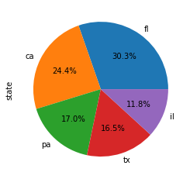
10) State wise analysis
In state wise analysis the fl ,ca and pa state has same seller , make, body type and model
Ca- california
Fl – florida
Pa – pennsylvania
Tx – texa
il - lllinois
sedan
(body)
the hertz corporation
(Seller)
State
(fl)
Altima
(Model)
Ford
(Make)

Slide 16
sedan
(body)
avis corporation
(Seller)
State
(tx)
impala
(Model)
Chevrolet
(Make)
sedan
(body)
ford motor credit company llc(Seller)
State
(il)
impala
(Model)
Chevrolet
(Make)

Slide 17
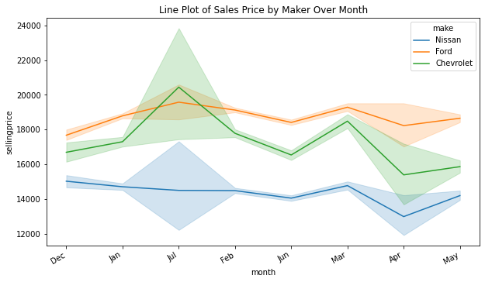
11) Line Plot of sale price by maker over month
Ford -42819
Nissan – 18001
Chevrole-21688

Slide 18
Conclusion :
The dataset tells us about car sales . In the dataset most car sale by the the hertz corporation and body type is sedan and model Fusion This information can help people decide when they want to buy or sell a car. It helps us understand how different factors affect like car model, body type etc
In this dataset analyze vehicle sales are most of the car are manufacture by Ford , body type sedan and other attributes over time and across different locations
Recommendations :
Choose newer cars: Newer cars are sold at higher prices, but they often come with better features and fewer issues.
Consider popular car brands: Some brands sell more cars because people trust them like Ford in our dataset and its body type is sedan . Look for top brands if you're buying or selling a car.
When we buying the new car we need to by the Car which are manufacture by the FORD
Because in our dataset most of the car sale by the brand Ford that’s why when buying new car that must be popular brand after some period when we need to sale that car its has value because of the brand
When need to buy by the second or old car we need buy that from the hertz corporation or avis corporation because most of the car sale by this to seller .

